Slide 1



Master of Science in Computer Engineering
Rethinking Automotive Software Development: Exploring Software Defined Vehicle and its potential
Candidate
Lorenzo SCIARA
Supervisors
prof. Danilo Bazzanella
dott.sa Piera Limonet

Slide 2
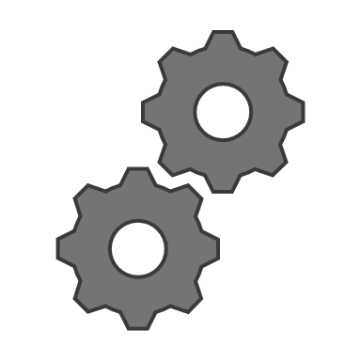

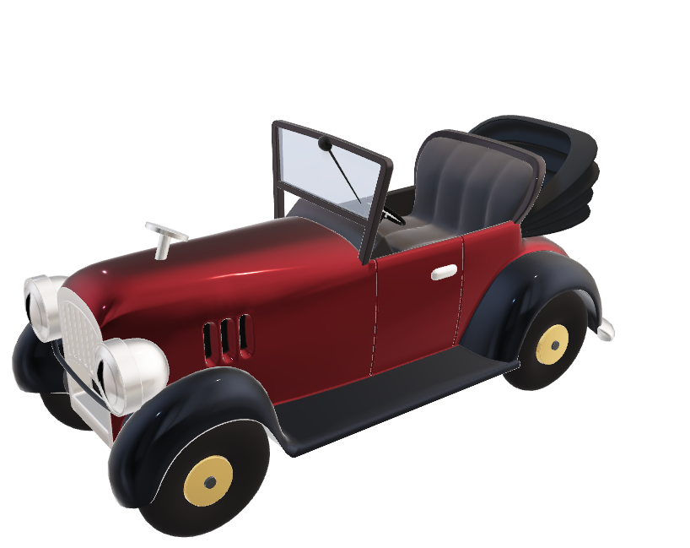
AUTOMOTIVE CONTEXT
MECHANICS
AGENDA
SOFTWARE
1. AUTOMOTIVE CONTEXT
2. SOFTWARE DEFINED VEHICLE
3. CLOUD COMPUTING
4. BENEFITS
5. CONTRIBUTORS
6. VALIDATION
7. FUTURE WORKS

Slide 3
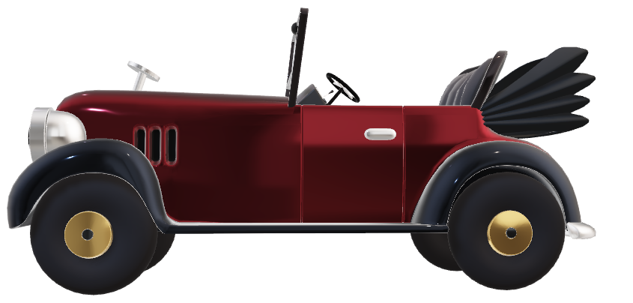
AUTOMOTIVE CONTEXT
In the past automotive industry software production was always considered secondary to the mechanical ones.
MECHANICS
SOFTWARE

Slide 4



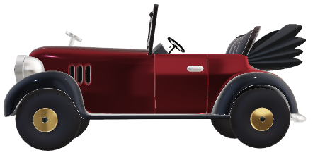
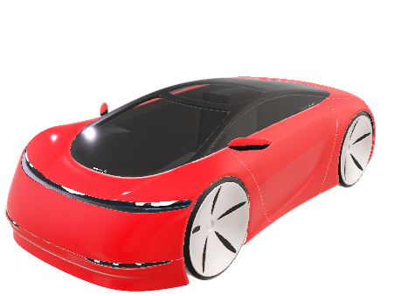
SOFTWARE DEFINED VEHICLE
AUTOMOTIVE CONTEXT
The focus on the mechanical parts of the vehicle resulted in software being very dependent on the hardware.
HARDWARE
MECHANICS
SOFTWARE
SOFTWARE

Slide 5




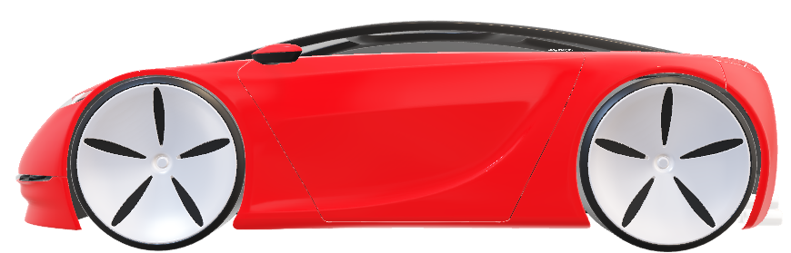
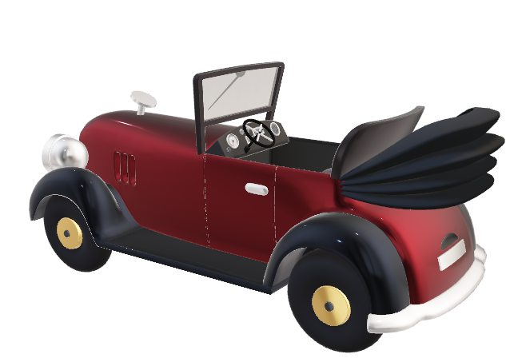
CLOUD COMPUTING
SOFTWARE DEFINED VEHICLE
Software Defined Vehicle enables software to become a fundamental element of vehicle design.
SECURITY
EFFICIENCY
DURABILITY
SOFTWARE
MECHANICS
HARDWARE

Slide 6
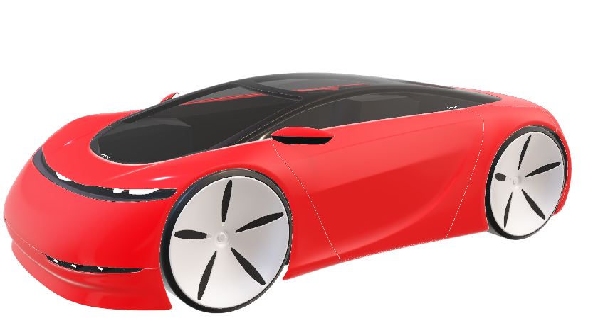
CLOUD COMPUTING
The vehicle is directly connected to the cloud
SOFTWARE
MECHANICS
HARDWARE

Slide 7
BENEFITS
CLOUD COMPUTING
SECURITY
EFFICIENCY
DURABILITY
The vehicle is directly connected to the cloud
Both for data analysis and to receive Over The Air (OTA) updates.

Slide 8
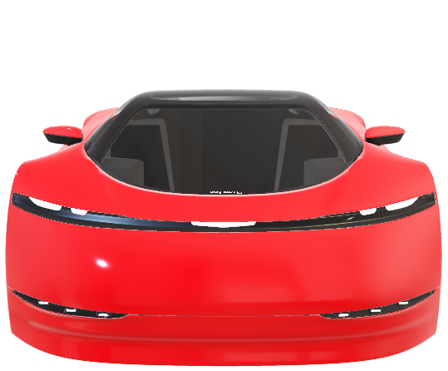
BENEFITS
SECURITY
EFFICIENCY
DURABILITY

Slide 9
BENEFITS
SECURITY
EFFICIENCY
DURABILITY
Vehicle vulnerabilities can be remotely fixed with OTA updates.

Slide 10
BENEFITS
EFFICIENCY
SECURITY
DURABILITY
Software independence significantly increases the efficiency of software production.

Slide 11
CONTRIBUTORS
BENEFITS
DURABILITY
SECURITY
EFFICIENCY
Vehicle lifecycle is extended through continuous updates and the addition of new features.

Slide 12


CONTRIBUTORS
BENEFITS
TCU SIMULATOR
CLOUD INFRASTRUCTURE
DATA VIEWER
SECURITY
EFFICIENCY
DURABILITY

Slide 13
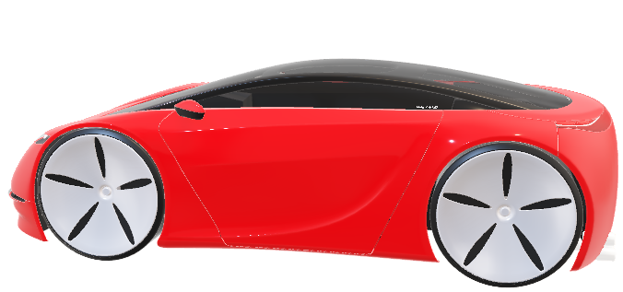
CONTRIBUTORS
SECURITY
EFFICIENCY
DURABILITY
TCU SIMULATOR
CLOUD INFRASTRUCTURE
DATA VIEWER

Slide 14
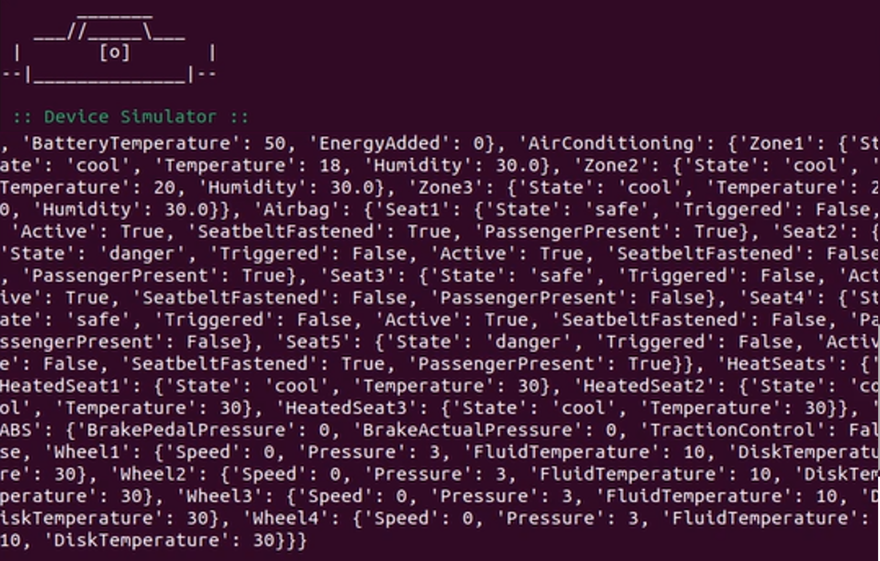
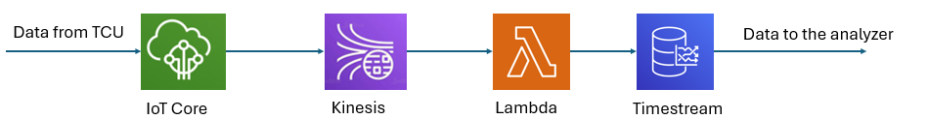
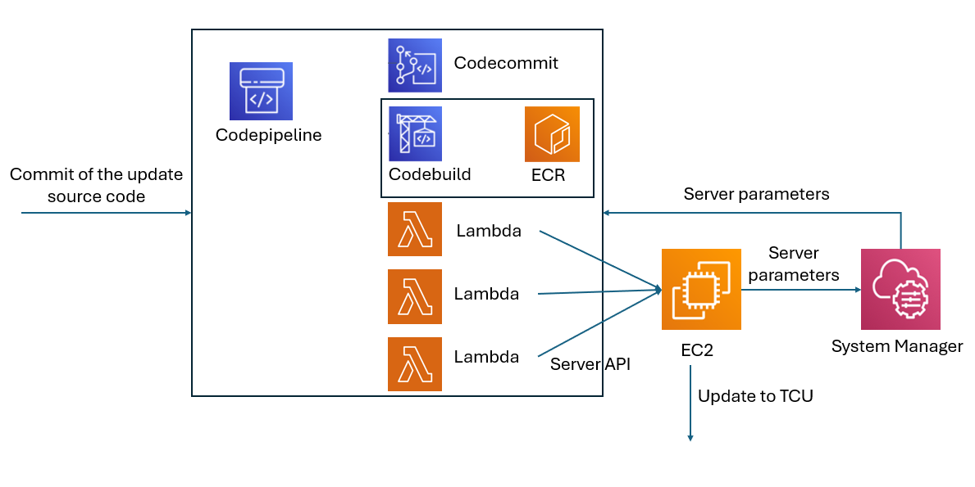
CONTRIBUTORS
TCU SIMULATOR
Telematic Control Unit (TCU) Simulator is a system that can collect and transmit data from simulated subsystems and integrate updates from external sources.
CLOUD INFRASTRUCTURE
DATA VIEWER
Using AWS services, two distinct cloud infrastructures can be built:
The first is for collecting data from the TCU simulator.
The second is to manage and deploy software updates using the Hawkbit server.

Slide 15
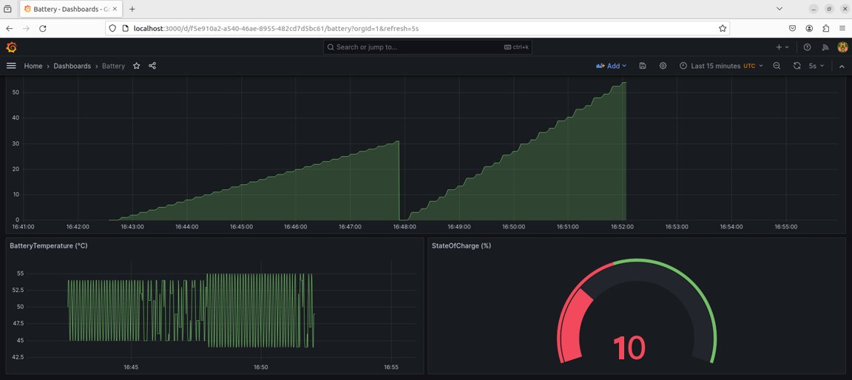
CONTRIBUTORS
TCU SIMULATOR
Telematic Control Unit (TCU) Simulator is a system that can collect and transmit data from simulated subsystems and integrate updates from external sources.
CLOUD INFRASTRUCTURE
DATA VIEWER
The data is displayed in an intuitive and user-friendly dashboard using a Grafana server thanks to the connection to the cloud infrastructure.
Using AWS services, two distinct cloud infrastructures can be built:
The first is for collecting data from the TCU simulator.
The second is to manage and deploy software updates using the Hawkbit server.

Slide 16
CONTRIBUTORS
TCU SIMULATOR
CLOUD INFRASTRUCTURE
DATA VIEWER
The data is displayed in an intuitive and user-friendly dashboard using a Grafana server thanks to the connection to the cloud infrastructure.
Using AWS services, two distinct cloud infrastructures can be built:
The first is for collecting data from the TCU simulator.
The second is to manage and deploy software updates using the Hawkbit server.

Slide 17
VALIDATION
CONTRIBUTORS
TCU SIMULATOR
CLOUD INFRASTRUCTURE
DATA VIEWER

Slide 18
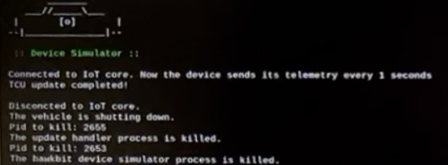
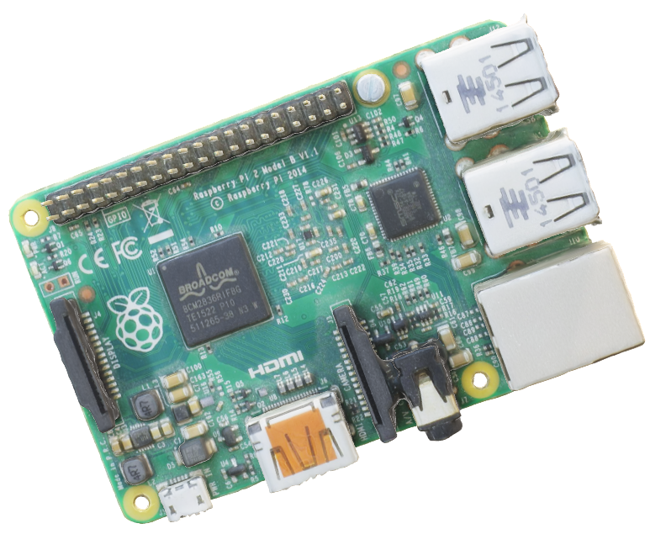
VALIDATION
The entire proof of concept is tested on a system that can simulate a vehicle TCU as closely as possible. For this reason, the RaspberryPi was chosen.

Slide 19
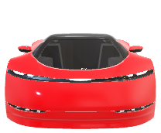
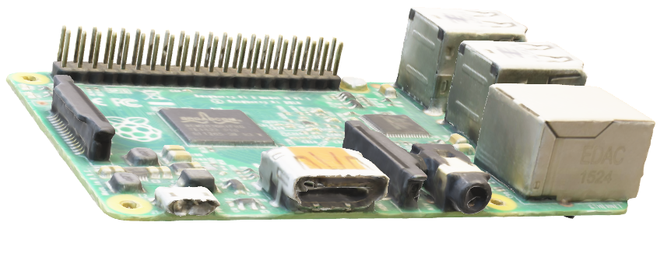
FUTURE WORKS
VALIDATION
SDV
AD
ML
VEHICLE APPLICATION
INTEGRATION

Slide 20

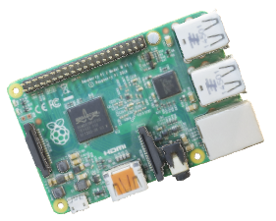
KEY POINTS
FUTURE WORKS
SDV
CLOOSER EXAMINATION
AD
ML
VEHICLE APPLICATION
INTEGRATION

Slide 21
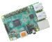
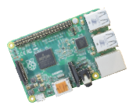
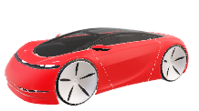
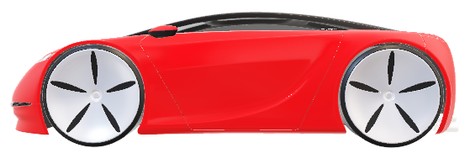
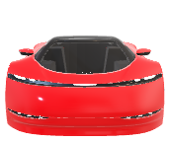
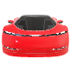
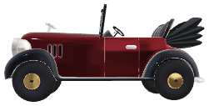
KEY POINTS
AUTOMOTIVE CONTEXT
SOFTWARE DEFINED VEHICLE
CLOUD
BENEFITS
CONTRIBUTORS
VALIDATION
FUTURE WORKS
SDV
AD
ML
Thanks for the attention
Any questions?

Slide 22
KEY POINTS
Thanks for the attention
Any questions?

